Slide 1

Airbnb Data Analysis
Sweta Patel - 100915164
Peter El Khoury - 100861813
Agnes Li - 100673905
Professor- Amir Rastpour

Slide 2
Outline
Business Case
Dataset
Preliminary Data Analytics
Exploratory Data Analytics
Emotional Analytics
Feature Importance
Model Building
Findings and Summary

Slide 3
Business Case
The question to investigate is;
What are the factors affecting the pricing of the listing?
This is essential for the hosts.
Setting the price correctly is crucial for Airbnb because an excessively expensive listing will result in fewer bookings, and an excessively low listing will result in a loss of profit for Airbnb. Regression analysis will aid in making some degree of accurate price prediction.
Based on sentimental analysis of the customer reviews, hosts will be able to understand the emotions of the customers and make necessary improvements as when required.

Slide 4
Dataset
The dataset is collected from insideairbnb.com which is mission driven project that provides research and advocacy on the impact of Airbnb on residential areas.
For our use case, we are using the Airbnb dataset for Toronto region.
The dataset contains the information about listings and the customer reviews for every listing starting from the year 2009 to 2023.
Listings dataset contains information about the hosts, properties and different review scores.
It contains 18921 observations with 75 features.
Reviews dataset contains information about the customer reviews for every listing.
It contains 4,82,000 observations with 6 features.
id | property_type
name | room_type
description | accommodates
host_id | bedrooms
host_name | bathrooms_text
host_since | beds
host_location | amenities
host_response_rate | price
host_acceptance_rate | has_availability
host_response_time | availability_30
host_is_superhost | number_of_reviews
host_identity_verified | review_scores_rating
host_verifications | review_scores_cleanliness
neighbourhood_cleansed | review_scores_communication
latitude | review_scores_checkin
longitude | review_scores_location
id
date
listing_id
reviewer_id
reviewer_name
comments
Reviews Table
Listings Table

Slide 5
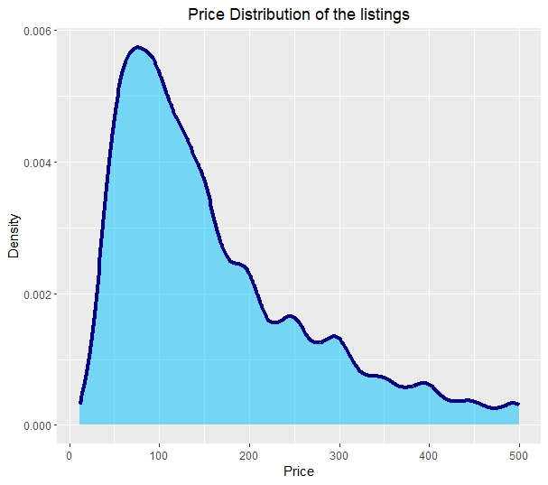
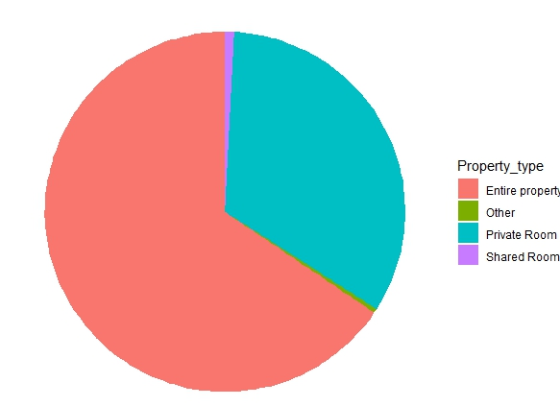
Preliminary Data Analytics
Missing or null values- Getting sum of null values for all variables and the ones with all null values like bathrooms were eliminated from the dataset. For some important features like review_scores_rating, null values were replaced by 0.
Removal of unimportant features- Many variables like listing_url, name, description, host_url,host_name etc. were removed.
Removing outliers- We analysed that about 95% of our data have the prices in the range of 0 to $500 and hence we removed the rest.
Releveling of data- Columns like property_type has lot of levels, so they are reduced to three levels namely shared room, private room, hotel room and other depending upon the input.
Similarly with amenities, new columns like basics, facilities, parking, bath_essentials, kitchen_appliances , safety_measures and long_term_stays_allowed and the original column is dropped.
Property type distribution of listings

Slide 6
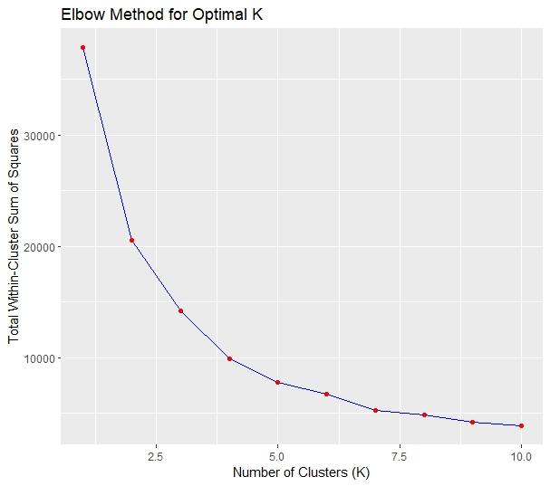
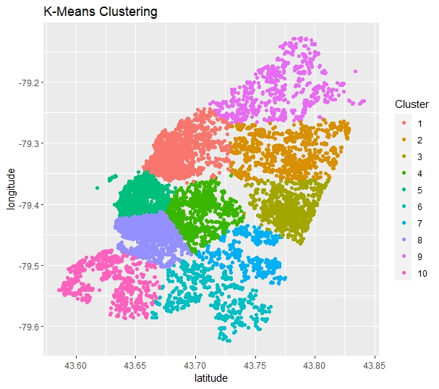
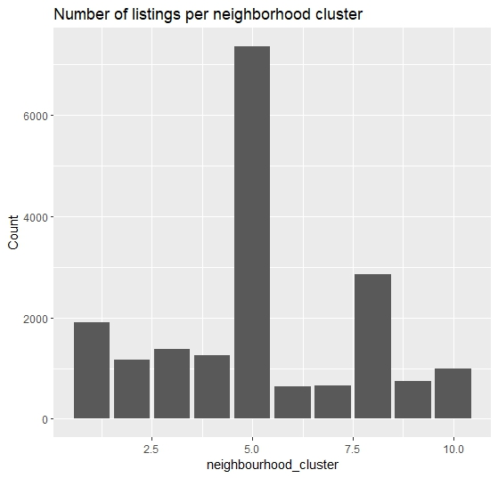
Preliminary Data Analytics
Columns like latitude and longitude of listing were used to group listings in clusters using KNN algorithm.

Slide 7
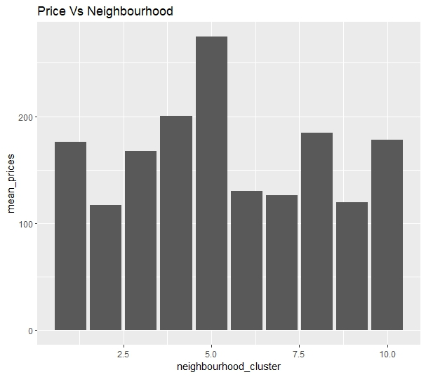
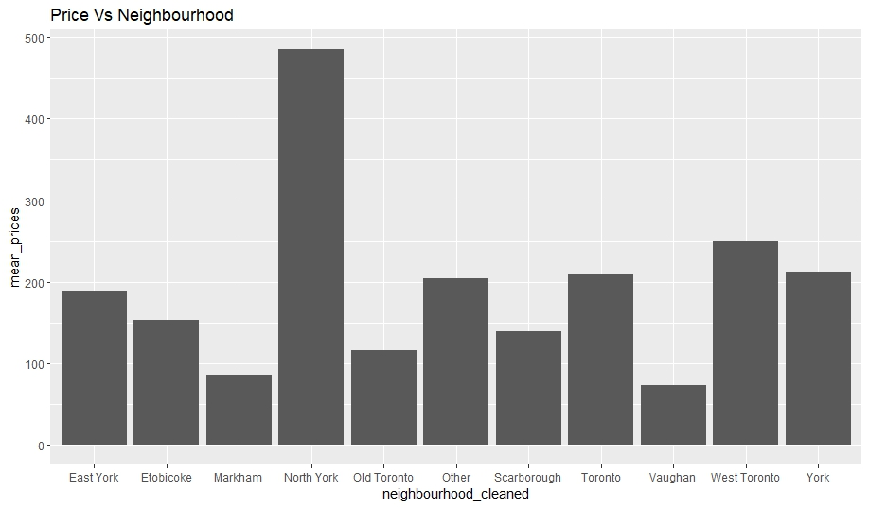
Exploratory Data Analysis

Slide 8
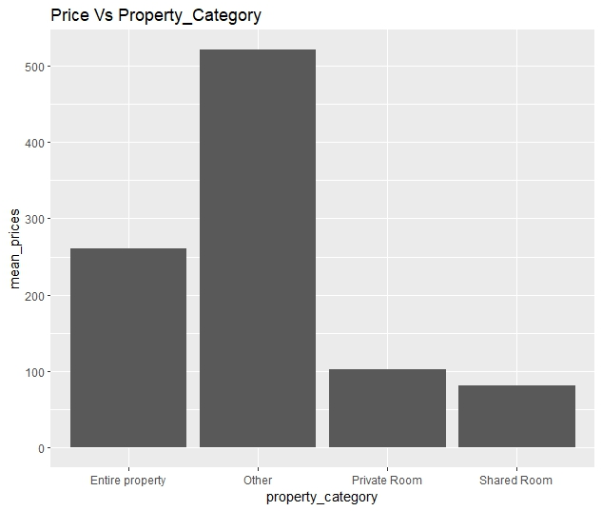
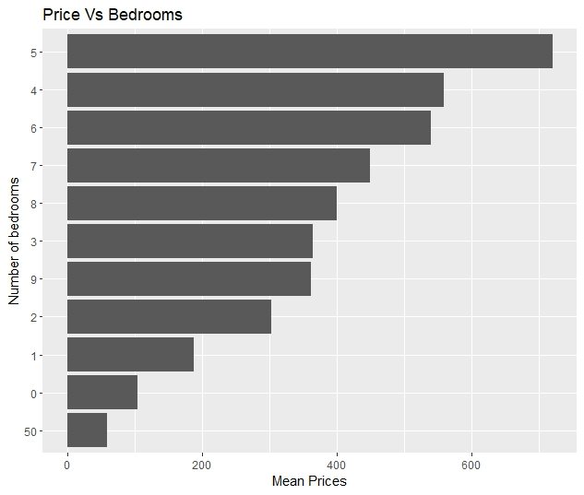
Exploratory Data Analysis

Slide 9
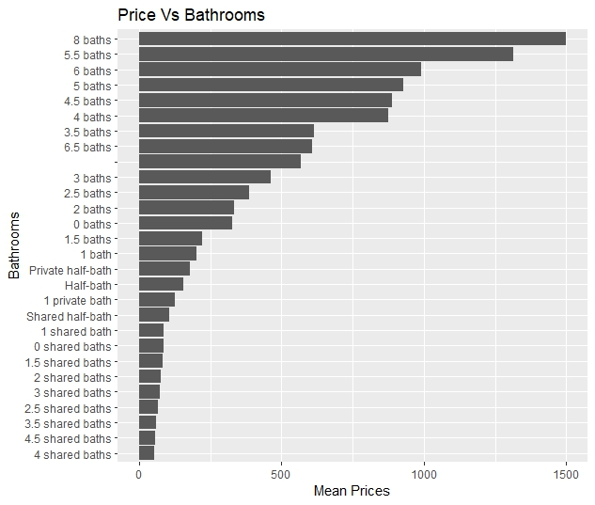
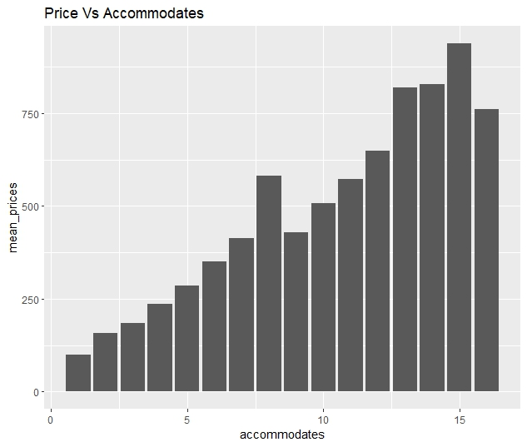
Exploratory Data Analysis

Slide 10
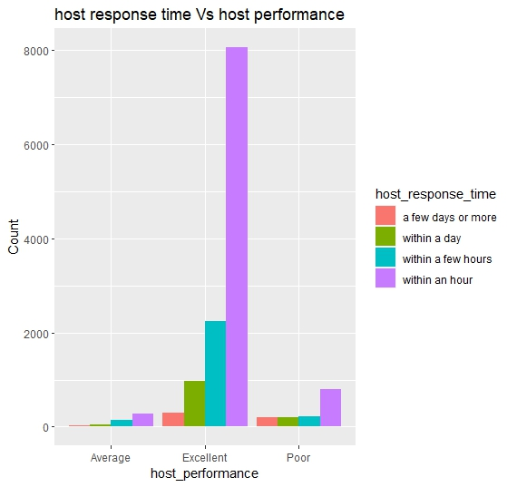
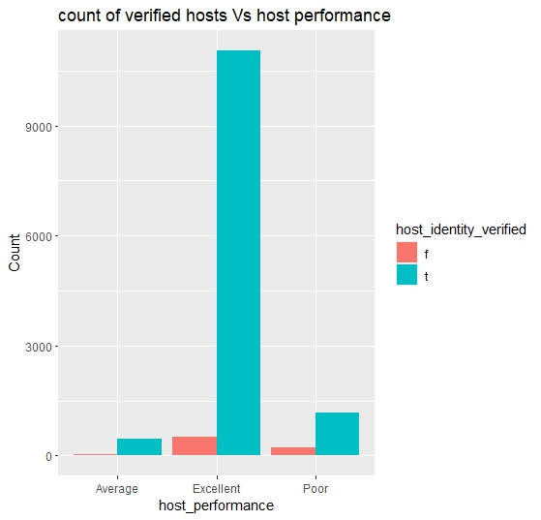
Exploratory Data Analysis
Based on customer review scores, performance of host is categorized as average, excellent and poor and then the traits of host is analysed.

Slide 11
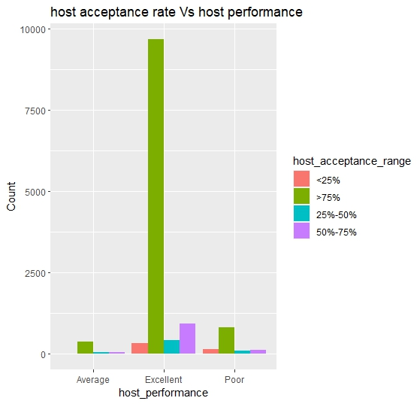
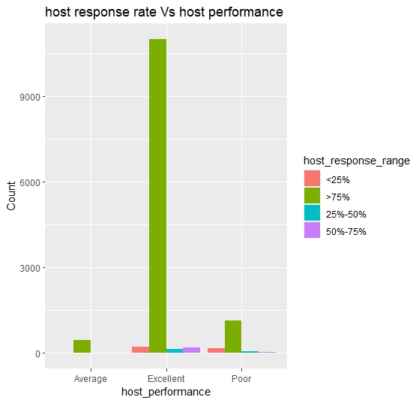
Exploratory Data Analysis
Based on customer review scores, performance of host is categorized as average, excellent and poor and then traits of host is analysed.

Slide 12
Review Analysis / Emotional Analysis
An emotional lexicon called the NRC Lexicon (National Research Council) attributes emotions to English words.
The comments on all the listings were analyzed.
anger
anticipation
disgust
fear
joy
negative
positive
sadness
surprise
trust
clean
trust
joy
positive
instructions
trust
anticipation

Slide 13
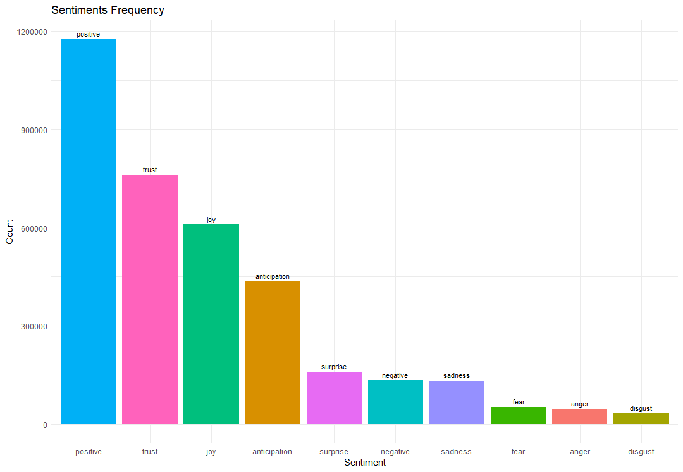
Sentiments Frequencies

Slide 14
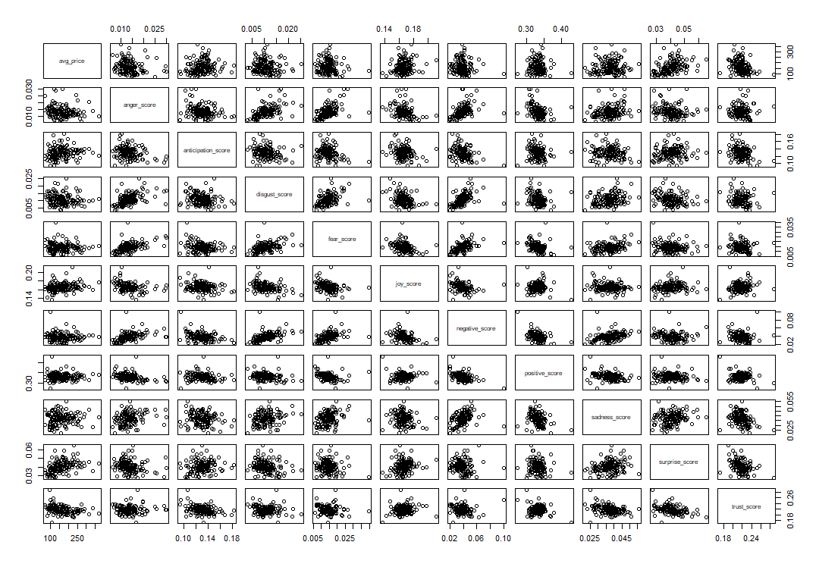

Slide 16
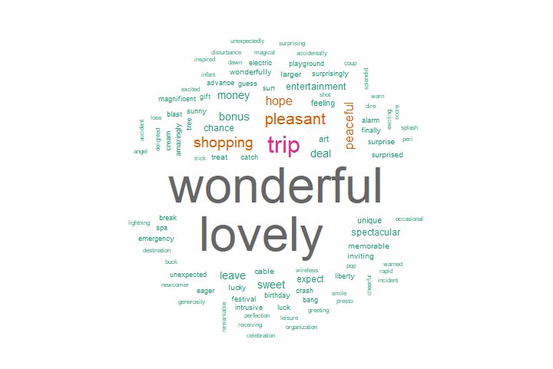
Top Words for Surprise
The word tree is of interest
Let’s see how it affects the avg. price per neighborhood.

Slide 17
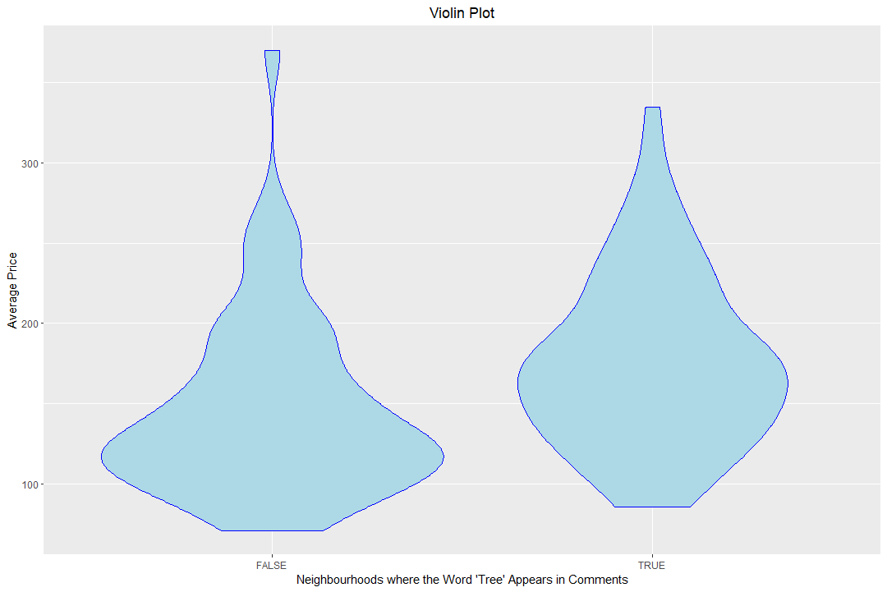
Top Words for Surprise

Slide 18
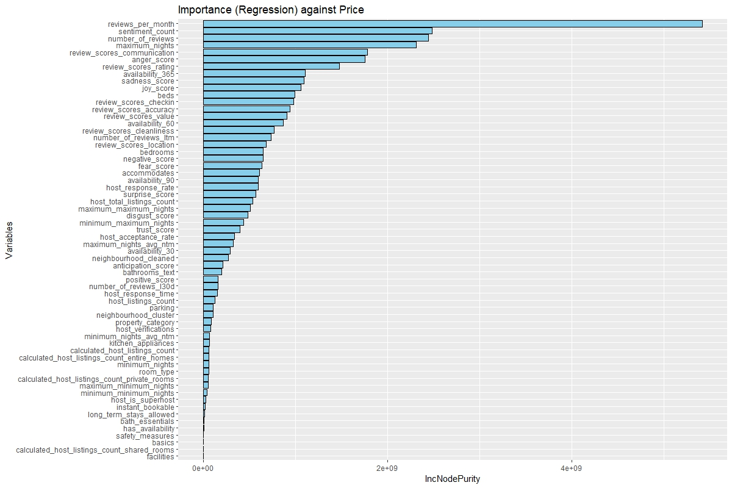
Feature Importance
Used RandomForest Algorithm to find out the significance of all the variables on our dependent variable which is price.
IncNodePurity- The amount that the model error rises when a specific variable is randomly permuted or shuffled.

Slide 19
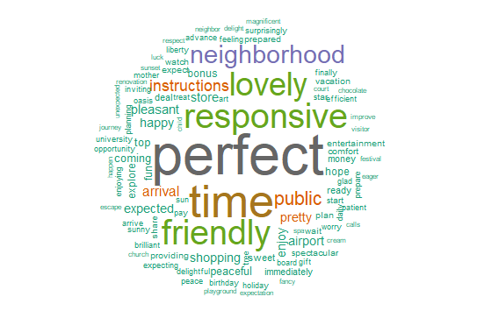
Random Forest for Sentiment Scores
Anticipation had the highest impact on price.
Top words conveying anticipation corroborate previous findings.

Slide 20
Building the Models
Two models were built:
Linear Regression Model
Random Forest
The top 50 variables from the IncNodePurity bar chart were used.
We compared the two models used 5-Fold cross-validation and then calculated the average RSEs for the test set.

Slide 21


Building the Models
Linear Model:
$k=5$
Mean RSE = 812
Random Forest:
$m=\sqrt{p}=\sqrt{51}=7$
Number of trees = 100
Mean RSE = 805

Slide 22
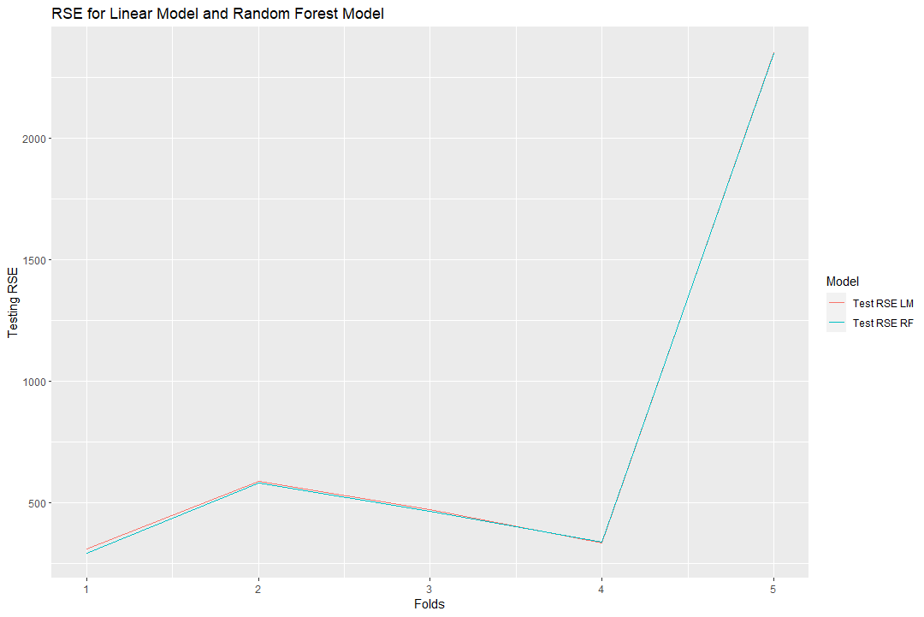
Building the Models

Slide 23
Findings and Summary
Through our analysis we conclude the following findings.
Assist hosts in determining the factors that influence the pricing of a listing.
Before posting a listing on Airbnb, our model provides hosts with a price proposal based on all relevant factors such as the listing's location, listed properties, available amenities, and so on.
Assist hosts in becoming aware of the characteristics they must maintain, such as response rate and acceptance rate, in order to better serve clients.
The model could help users understand the reviews of a listing using the emotion metric.

Slide 24

Questions

